Slide 1
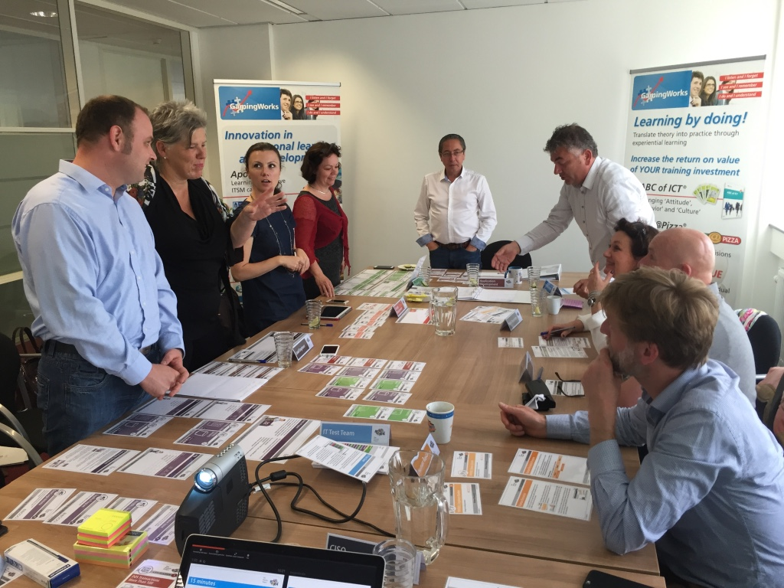
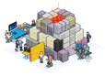
DevOps Will Fail… unless
How Simulation will help!
The
Phoenix Project
Jan Schilt, CEO
GamingWorks BV

Slide 2
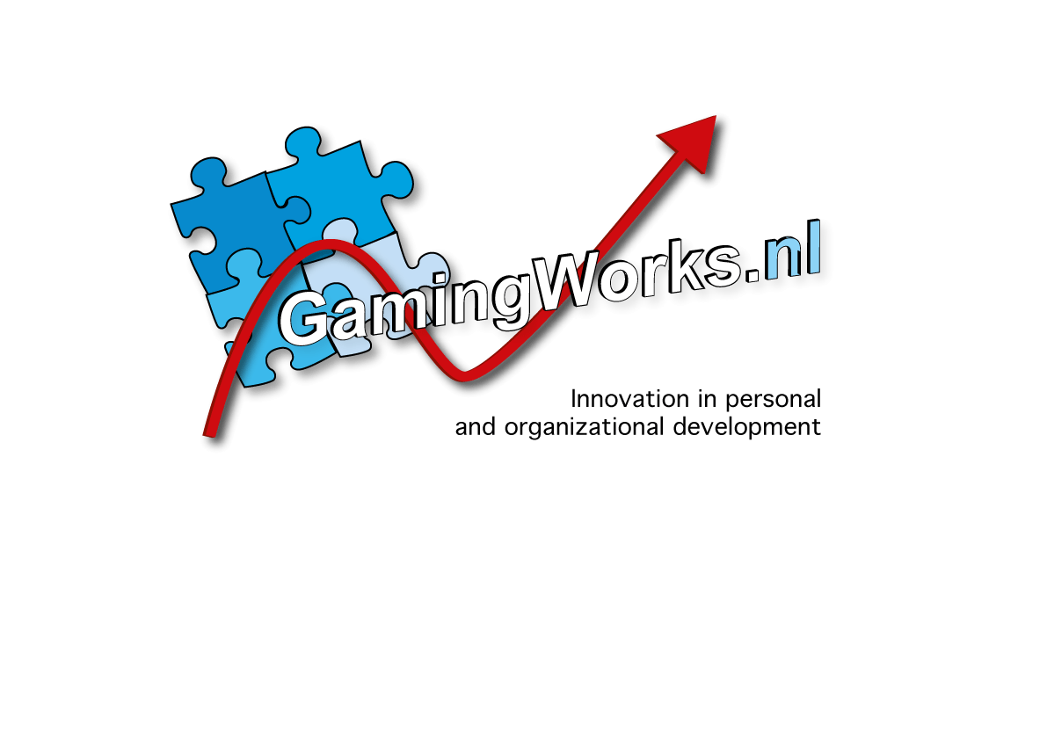
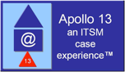




About GamingWorks
Dutch company, founded 2001, Paul Wilkinson and Jan Schilt
Designers of Serious Business Simulations (interactive, team-sessions)
300 partners, 40 countries, 400+ trainers
500+ runs a year

Slide 3
Why will DevOps fail?
LACK of right CULTURE, lack of right COMPETENCES
NEW FRAMEWORK
TOOLS are THE SOLUTION
Certificates
Fast implementation of DevOps
“Cultural resistance will create significant failure rates when starting with DevOps”
“Organizational change issues are far more challenging”
“Enterprises are not ready for DevOps but will not survive without it”

Slide 4
Why will DevOps fail?
“DevOps cannot be obtained overnight with a simple check and a little training. It is a transformational approach to core processes and it takes time, dedication and especially a team that can implement DevOps practice.”

Slide 5
How do we know?
Feedback from 5000+ sims (ITSM, PM)
Unclear Roles and Responsibilities
Lack of Management Buy-in, commitment
Lack of business focus
Them and us
No time for doing it right
No link People, Process, Product and Partner
Communication

Slide 6
What is DevOps?
DevOps is a cultural and professional movement that stresses communication, collaboration and integration between software developers and IT operations professionals.
(c) DevOps Institute

Slide 7
So, how can we avoid failure?
Business awareness
Senior (IT) management awareness
Focus on people (attitude, behavior, skills, communication)
Focus on teamwork (collaboration)
First processes and behavior then tool
Learning by doing culture
Transfer theory into practice
Integration in current way of working
Transformation approach
THIS CANNOT BE ACHIEVED WITHOUT THE RIGHT TRAINING !!!

Slide 8
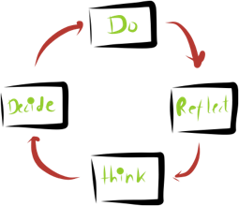
What is a Serious Business Simulation?
Interactive learning activity
Group of learners, face to face
Actors in a challenging, realistic context
Focus of specific learning objectives
Aimed at solving day to day problems
Based on Learning by doing

Slide 9
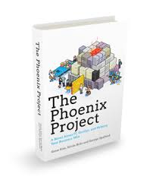
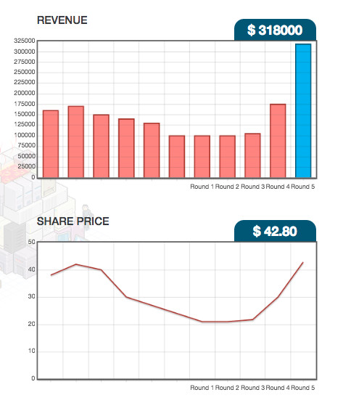
The Phoenix Project simulation
Notes:
Jan I have added VALUE as the most important aspect for me…..many are too internally focused thinking it is all about code, deployment, continuous delivery…..all these other aspects are tools (e.g Kanban, wip)….the ultimate goal is to deliver business value…..actually it should be called bus-dev-ops….in the simulation we can also INCLUDE the business and team success depends upon delivering agreed value to the business,
…If you want YOUR business to buy-in to DevOps you must demonstrate the value it gives them.

Slide 10

The Phoenix Project Simulation
10-12 participants
“The Phoenix Project”
Business & IT roles
Issues from the book
Experiencing top 10 DevOps challenges
Bringing real value to the business
Reflection, experimenting, learning
Finding solutions
… and how to implement them in own work

Slide 11
Subjects during the sim
Visualization
Flow
Collaboration
Communication
3 ways
Silo thinking
Lean
Agile
ITSM
Rework
Disruptions
Continuous Learning
RACI
Business VALUE
Decision Making
Training
Multifunctional teams
Sharing Knowledge
Standups
Product Owner
Feedback
Improving
Metrics
Priorities
Bottlenecks
Constrains
Celebrate
© GamingWorks

Slide 12
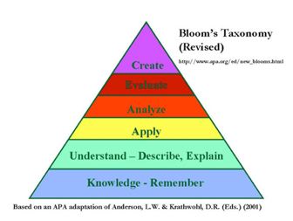
Why is a simulation a must have?
End-to-end working together in a safe environment
Focus on behaviors, interaction, teamwork, communication
Continual learning and improvement (Learning Cycle)
Develops understanding and application of knowledge
It fits 70/20/10 learning approach
Focus on relevant issues

Slide 13
When to use?
After DevOps foundation -> Apply theory
To create Business Awareness -> Play with business
To assess current status -> Gap analyse
To develop IT awareness -> DEV & OPS
To practice working together -> DEV & OPS...and Business
To explore solutions -> DEV & OPS
To train ‘This is how we do IT’ -> DEV & OPS
Before we start anything else
“If we had this simulation 5 years earlier, we would have made bigger steps in our journey”
Jonathan Leckey – Head Operations AutoTrader

Slide 14
Questions after the session…
How to…
... lead standup meetings?
… use KanBan?
… improve processes?
… make the right decisions?
… apply CALMS?
… stimulate teamwork?
… deal with FLOW?
… deal with Feedback?
… develop learning culture?
… avoid rework

Slide 15
Thanks for your interest…
If you want to meet me in real life ?
Contact one of our partners on
www.gamingworks.nl
Time for Questions…

